Slide 1
Stored-program Concept and IAS Computer
Yuemin Ding
Tecnun, University of Navarra
Fall, 2021

Slide 2
Outline
Stored-program concept
IAS Computer

Slide 3
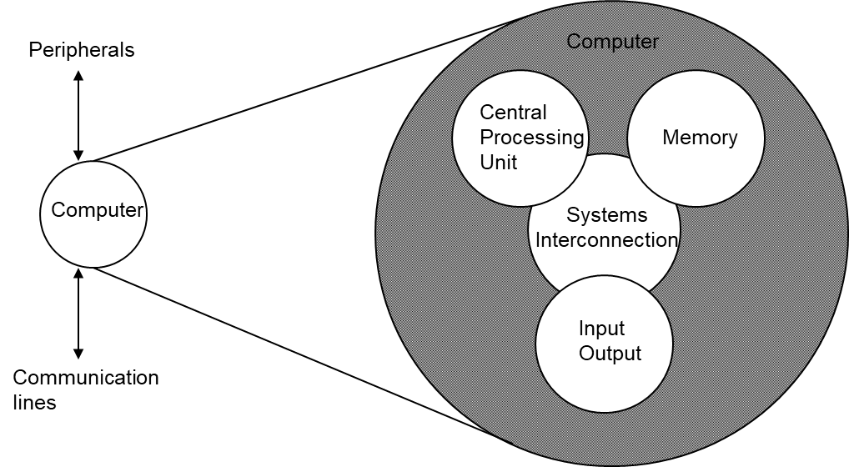
Quick Review
Computer structure
Basic functions of computer:
Data processing
Data storage
Data movement
Control

Slide 4
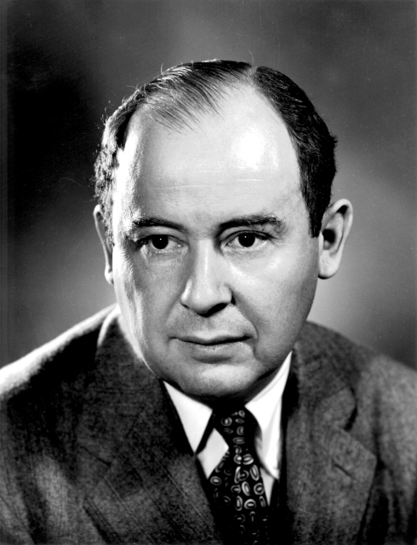
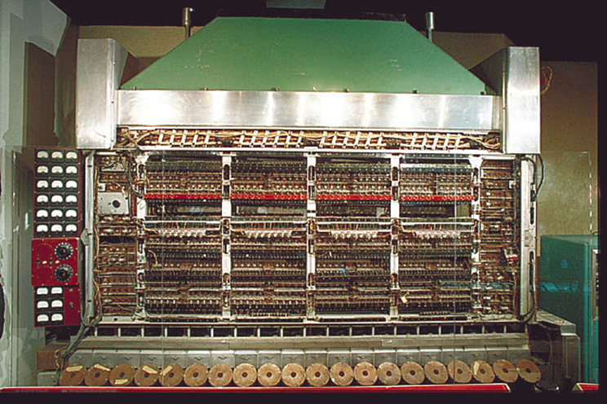
Stored-program Concept
In 1946, John von Neumann and his colleagues began the design of a new stored-program computer at the Princeton Institute for Advanced Studies (IAS), called IAS computer.
The IAS computer is the prototype of all subsequent general-purpose computers.
Stored-program computers have become known as von Neumann Architecture systems.

Slide 5
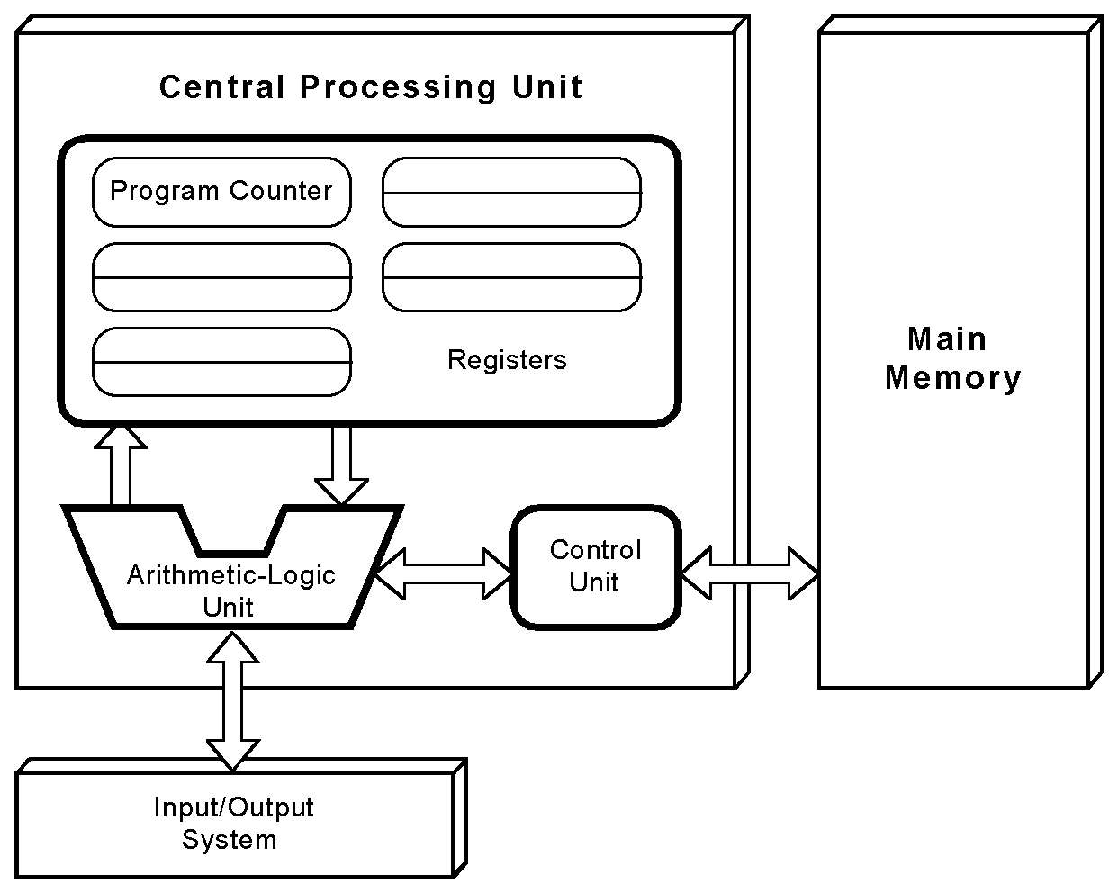
Stored-program Concept
Stored-Program concept
  Main memory storing programs and data
  ALU operating on binary data
  Control unit interpreting instructions from memory and executing
  Input and output equipment operated by control unit

Slide 6
Stored-program Concept
The program and data are stored in the main memory
These computers employ a fetch-decode-execute cycle to run programs.
Instructions
data

Slide 7
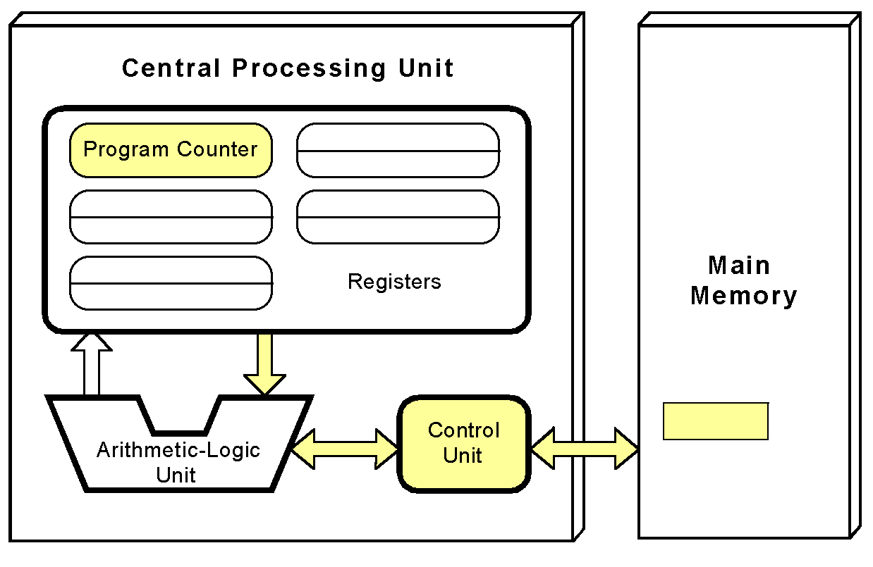
Stored-program Concept
The control unit fetches the next instruction from memory using the program counter
The program counter indicates where the instruction is located.
Add A, B

Slide 8
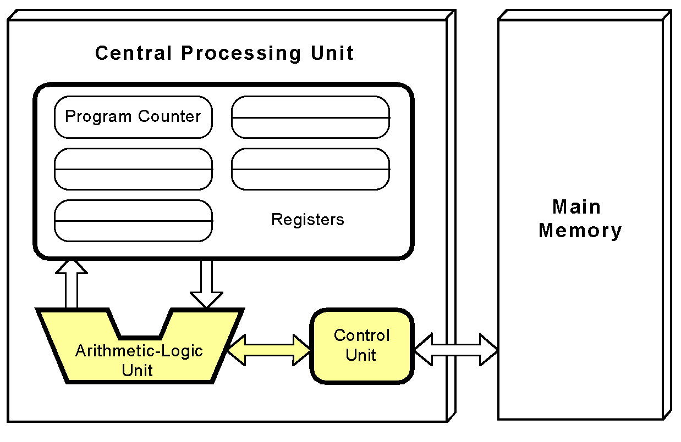
Stored-program Concept
The instruction is decoded into a language that the ALU can understand.
00000101
Add A, B

Slide 9
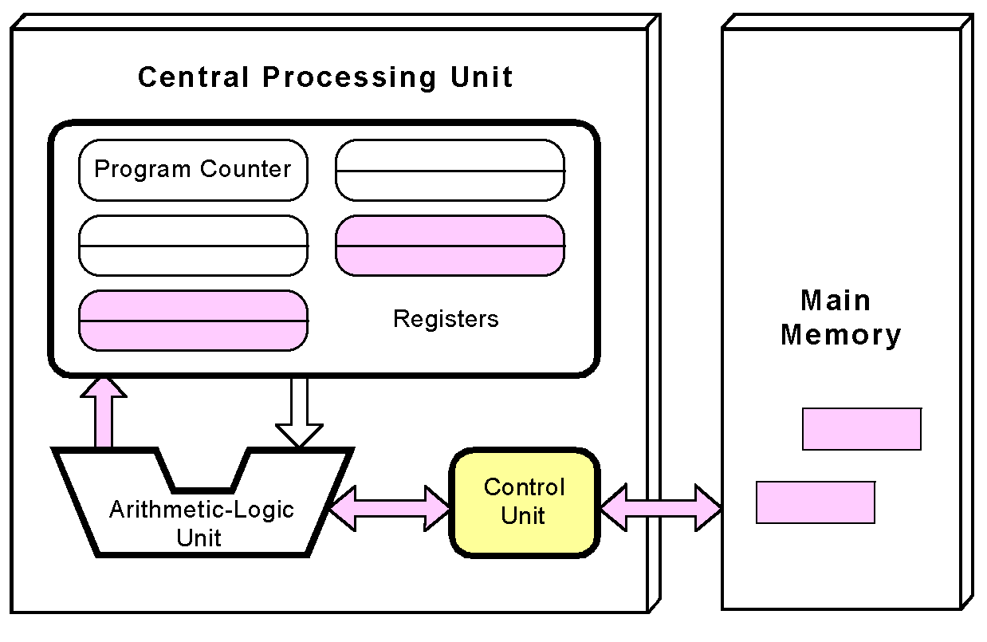
Stored-program Concept
Any data operands required to execute the instruction are fetched from memory and placed into registers within the CPU.
A
B
A
B

Slide 10
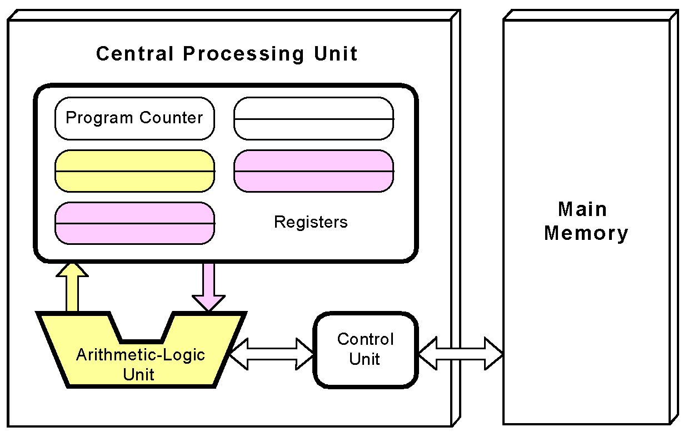
Stored-program Concept
The ALU executes the instruction and places results in registers or memory.
A+B
A+B

Slide 11
Outline
Stored-program concept
IAS Computer

Slide 12
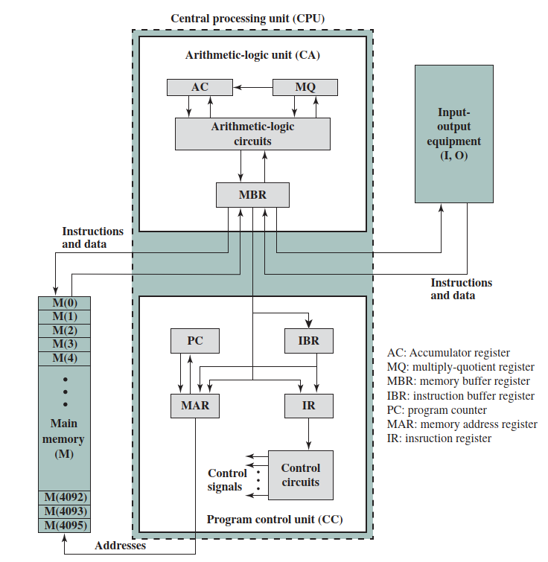
IAS Structure
40 bits

Slide 13
Registers
Set of registers (storage in CPU)
  Memory Buffer Register (MBR): Contains a word to be write to/receive from memory or I/O unit.
  Memory Address Register (MAR): Specifies the address in memory of the word to written from/ read into the MBR
  Instruction Register (IR): Contains the 8-bit opcode being executed
  Instruction Buffer Register (IBR): Hold temporarily the right-hand instruction
  Program Counter (PC): Contains the address of the next instruction pair to be fetched from memory
  Accumulator (AC) and Multiplier Quotient (MQ) : hold temporarily operands and results of ALU operations

Slide 14
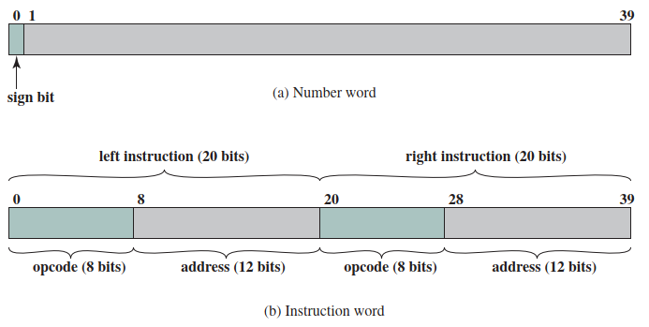
Memory Formats
Memory storage: 4096 words (40 bit )
  Binary number
  2 x 20 bit for instruction

Slide 15
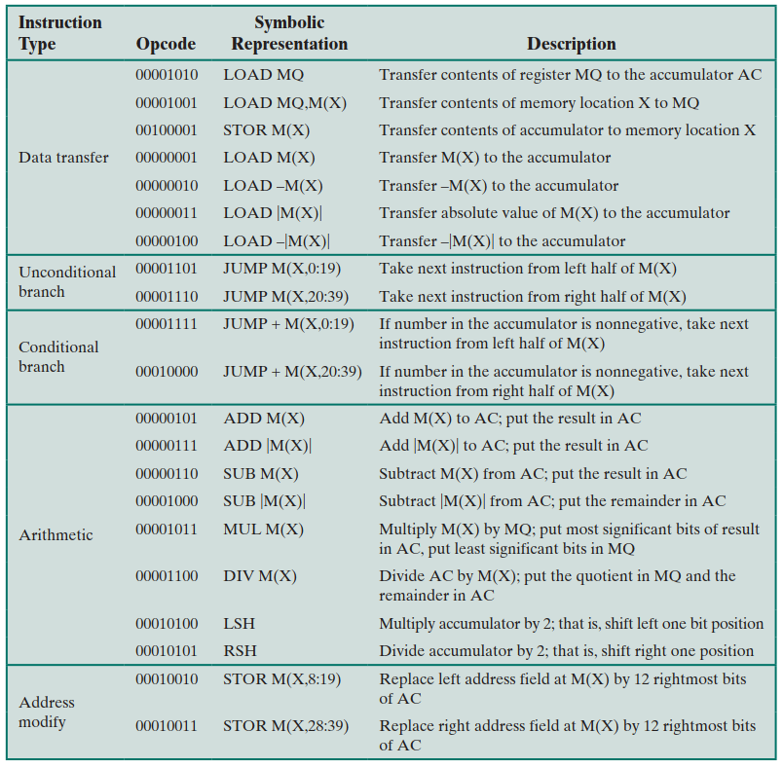
Instruction Set
Six types of instructions are defined in the IAS computer:
Data transfer
Unconditional branch
Conditional branch
Arithmetic
Address modify

Slide 16
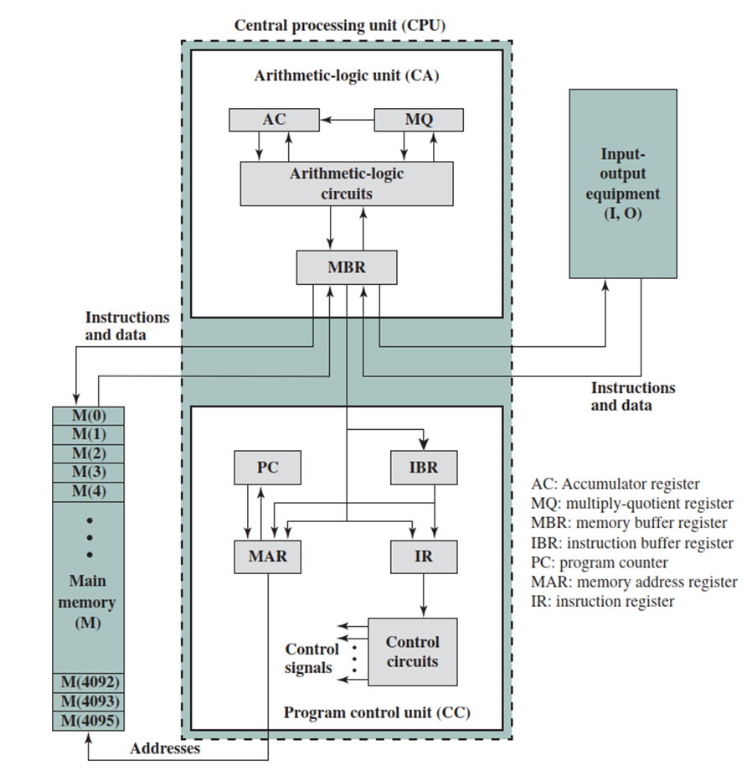
Instruction Set – data transfer (7)
00001010, LOAD MQ
Transfer contents of register MQ to the accumulator AC
00001001 X, LOAD MQ,M(X)
Transfer contents of memory location X to MQ
00100001 X, STOR M(X)
Transfer contents of accumulator to memory location X
00000001 X, LOAD M(X)
Transfer M(X) to the accumulator

Slide 17
Instruction Set – data transfer
00000010 X, LOAD -M(X)
Transfer -M(X) to the accumulator
00000011 X, LOAD |M(X)|
Transfer |M(X)| to the accumulator
00000100 X, LOAD -|M(X)|
Transfer -|M(X)| to the accumulator

Slide 18
Instruction Set – unconditional branch (2)
00001101 X, JUMP M(X,0:19)
Take next instruction from left half of M(X)
00001110 X, JUMP M(X, 20:39)
Take next instruction from right half of M(X)

Slide 19
Instruction Set – conditional branch (2)
00001111 X, JUMP M(X,0:19)
If number in the accumulator is nonnegative, take next instruction from left half of M(X)
00010000 X, JUMP M(X, 20:39)
If number in the accumulator is nonnegative, take next instruction from right half of M(X)

Slide 20
Instruction Set – arithmetic (8)
00000101 X, ADD M(X)
Add M(X) to AC; put the result in AC
00000111 X, ADD |M(X)|
Add |M(X)| to AC; put the result in AC
00000110 X, SUB M(X)
Subtract M(X) from AC; put the result in AC
00001000 X, SUB |M(X)|
Subtract |M(X)| from AC; put the remainder in AC

Slide 21
Instruction Set – arithmetic (8)
00001011 X, MUL M(X)
Multiply M(X) by MQ; put most significant bits of result in AC, put least significant bits in MQ
00001100 X, DIV M(X)
Divide AC by M(X); put the quotient in MQ and the remainder in AC
00010100, LSH
Multiply accumulator by 2; that is, shift left one bit position
00010101, RSH
Divide accumulator by 2; that is, shift right one position

Slide 22
Instruction Set – address modify (2)
00010010 X, STOR M(X,8:19)
Replace left address field at M(X) by 12 rightmost bits of AC
00010011 X, STOR M(X,28:39)
Replace right address field at M(X) by 12 rightmost bits of AC

Slide 23
Exercise
Data A,B,C stored in memories 000000010001(X_{a})~000000010011(X_{c}), write a program to calculate the sum Z=A+B+C and store it in Memory 000000010100(X_{z}).

Slide 24
Exercise
Data A,B,C stored in memories 000000010001(X_{a})~000000010011(X_{c}), write a program to calculate the sum Z=A+B+C and store it in Memory 000000010100(X_{z}).
Code:
LOAD X_{a}
ADD X_{b}
ADD X_{c}
STOR X_{z}

Slide 25
Exercise
Data A,B,C stored in memories 000000010001(X_{a})~000000010011(X_{c}), write a program to calculate the sum Z=A+B+C and store it in Memory 000000010100(X_{z}).
Code:
LOAD X_{a}
ADD X_{b}
ADD X_{c}
STOR X_{z}
Binary format?

Slide 26
Exercise
Data A,B,C stored in Memories 000000010001(X_{a})~000000010011(X_{c}), write a program to calculate the sum Z=A+B+C and store it in Memory 000000010100(X_{z}).
Code:
LOAD X_{a}
ADD X_{b}
ADD X_{c}
STOR X_{z}
Hexadecimal format?
00000001 000000010001
00000101 000000010010
00000101 000000010011
00100001 000000010100
Notes:
Stored program:
000 01 011 05 012
001 05 013 21 014
011 00 000 00 001
012 00 000 00 002
013 00 000 00 003

Slide 27
Exercise
Data A,B,C stored in Memories 000000010001(X_{a})~000000010011(X_{c}), write a program to calculate the sum Z=A+B+C and store it in Memory 000000010100(X_{z}).
Code:
LOAD X_{a}
ADD X_{b}
ADD X_{c}
STOR X_{z}
Hexadecimal format?
01 011
05 012
05 013
21 014
00000001 000000010001
00000101 000000010010
00000101 000000010011
00100001 000000010100
Notes:
Stored program:
000 01 011 05 012
001 05 013 21 014
011 00 000 00 001
012 00 000 00 002
013 00 000 00 003

Slide 28
Exercise
An IAS Simulator:
https://www.ic.unicamp.br/~edson/disciplinas/mc404/2017-2s/abef/IAS-sim/
Stored program
000 01 011 05 012
001 05 013 21 014
011 00 000 00 001
012 00 000 00 002
013 00 000 00 003
Code:
LOAD X_{a}
ADD X_{b}
ADD X_{c}
STOR X_{z}
A=1
B=2
C=3
Address
Hexadecimal format
01 011
05 012
05 013
21 014
00000001 000000010001
00000101 000000010010
00000101 000000010011
00100001 000000010100
Notes:
Stored program:
000 01 011 05 012
001 05 013 21 014
011 00 000 00 001
012 00 000 00 002
013 00 000 00 003

Slide 29
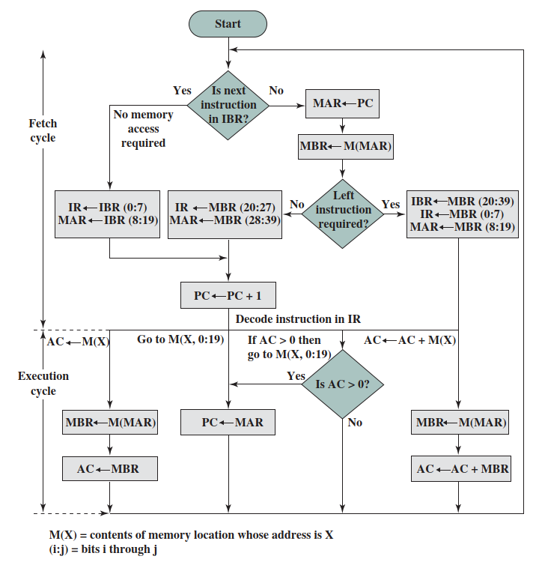
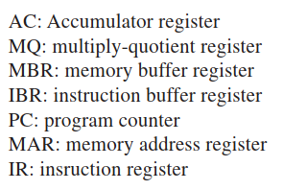
Operation flowchart

Slide 30
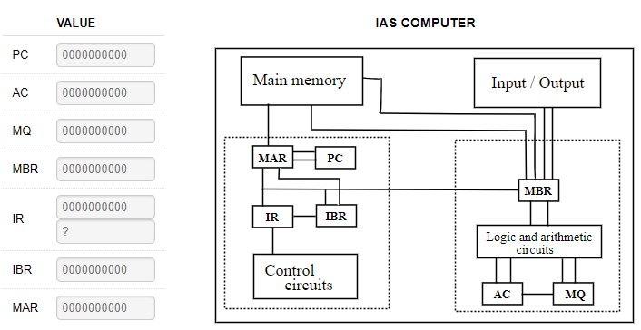
Operation Example
Initial state
Stored program
000 01 011 05 012
001 05 013 21 014
011 00 000 00 001
012 00 000 00 002
013 00 000 00 003

Slide 31
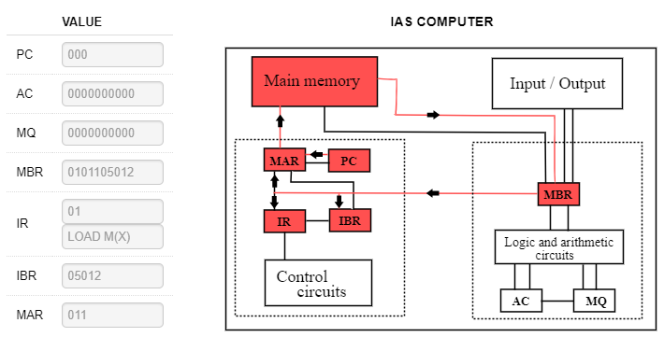
Operation Example
Fetch cycle (left)
Stored program
000 01 011 05 012
001 05 013 21 014
011 00 000 00 001
012 00 000 00 002
013 00 000 00 003

Slide 32
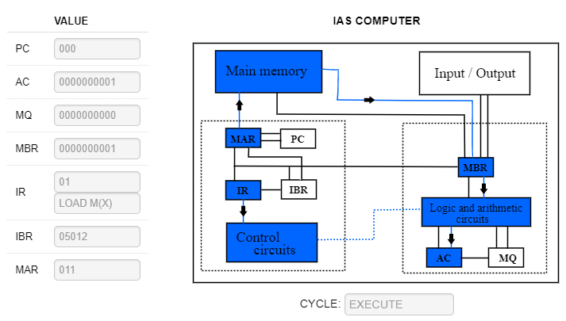
Operation Example
Execution cycle
Stored program
000 01 011 05 012
001 05 013 21 014
011 00 000 00 001
012 00 000 00 002
013 00 000 00 003

Slide 33
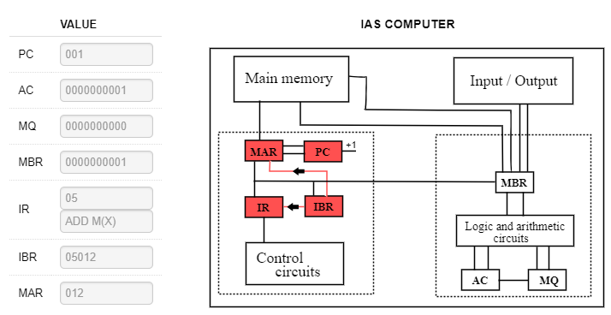
Operation Example
Fetch cycle (right)
Stored program
000 01 011 05 012
001 05 013 21 014
011 00 000 00 001
012 00 000 00 002
013 00 000 00 003

Slide 34
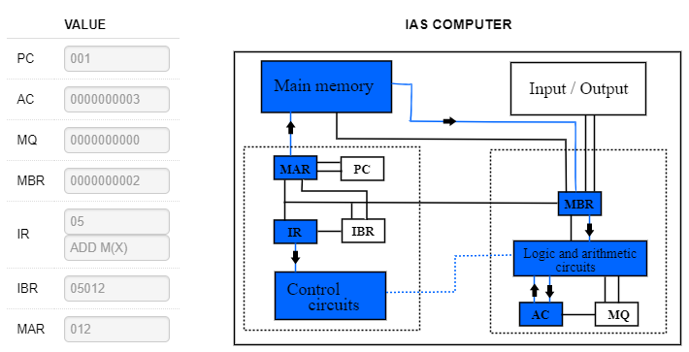
Operation Example
Execution cycle
Stored program
000 01 011 05 012
001 05 013 21 014
011 00 000 00 001
012 00 000 00 002
013 00 000 00 003

Slide 35
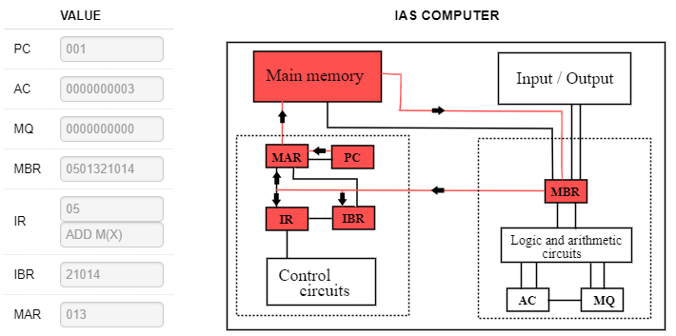
Operation Example
Fetch cycle (left)
Stored program
000 01 011 05 012
001 05 013 21 014
011 00 000 00 001
012 00 000 00 002
013 00 000 00 003

Slide 36

Operation Example
Execution cycle
Stored program
000 01 011 05 012
001 05 013 21 014
011 00 000 00 001
012 00 000 00 002
013 00 000 00 003

Slide 37
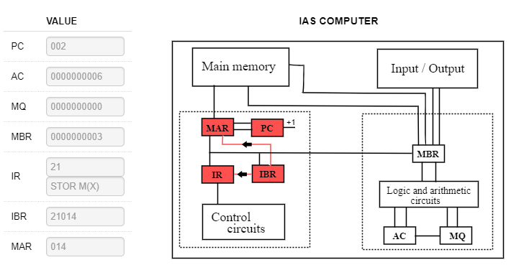
Operation Example
Fetch cycle (right)
Stored program
000 01 011 05 012
001 05 013 21 014
011 00 000 00 001
012 00 000 00 002
013 00 000 00 003

Slide 38
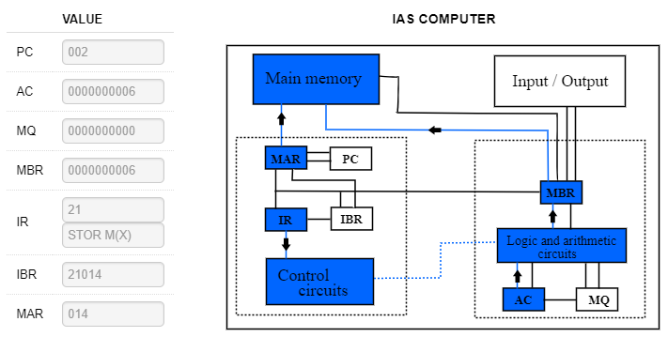

Operation Example
Execute cycle
Memory
Stored program
000 01 011 05 012
001 05 013 21 014
011 00 000 00 001
012 00 000 00 002
013 00 000 00 003
Result
Notes:
AC→MBR
MBR→M(MAR)

Slide 39
Thank you!
Q&A

